Slide 1
MLP (Multi Layer Perception)
Pranaav Paladugu and Oliver Grudinski

Slide 2
Overview of the Algorithm – Name and Purpose
The algorithm is called a Multi-Layer Perceptron (MLP), which is used to solve Classification problems (e.g., binary and multi-class classification) and Regression problems (predicting continuous values).

Slide 3
Overview of the Algorithm – Background
The first perceptron was introduced by Frank Rosenblatt in 1958.
In the 1980s, Geoffrey Hinton, David Rumelhart, and Ronald Williams developed the algorithm, which enabled MLPs to be trained effectively.
The purpose of developing the MLP was to create a computational model inspired by biological neurons, allowing machines to learn complex, non-linear patterns.

Slide 4
Overview of the Algorithm – Applications
It is commonly used for:
Image-Based Tasks - Handwritten digit recognition
Finance & Business - Fraud detection
Medicine & Healthcare - Disease prediction
Time-Series & Forecasting - Stock movement prediction

Slide 5
Problem Type
A Multi-Layer Perceptron (MLP) is a category of supervised learning, specifically in use for both classification and regression tasks.
In supervised learning, the model is trained on labeled data, meaning each input example has a corresponding known output.
The MLP uses these labeled examples to learn the underlying patterns by adjusting the weights between neurons.

Slide 6
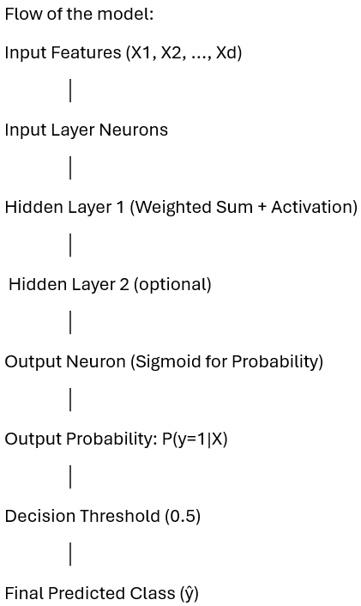
How the Algorithm Works?
Notes:
1. Input Features (X₁, X₂, …, Xd)
These are the variables or attributes used to make predictions. Each feature represents some measurable characteristic of the data.
2. Weighted Sum: z = w₁X₁ + w₂X₂ + … + wd*Xd + b
Logistic regression first computes a linear combination of the input features.
- Each feature $X_{i}$is multiplied by a learnable weight $w_{i}$.
- A bias term $b$is added to shift the decision boundary.
3. Sigmoid Activation: σ(z) = 1 / (1 + exp(-z))
Because classification requires a probability between 0 and 1, logistic regression passes the linear output $z$through the sigmoid (logistic) function.
- The sigmoid function “squashes” any real-valued number into a range from 0 to 1.
- A larger value of $z$results in a probability close to 1, while a very negative $z$ produces a probability close to 0.
4. Output Probability: P(y = 1 | X) = σ(z)
The result of the sigmoid function is interpreted as the predicted probability that the target class $y$is equal to 1 given the input features $X$.
For example, the model might output:
- 0.87 → 87% chance of “positive” or class 1
- 0.12 → 12% chance of class 1
5. Decision Threshold (default = 0.5)
To convert the probability into a class label, logistic regression uses a threshold.
- If the probability is greater than or equal to 0.5, the prediction is class 1.
- If it is less than 0.5, the prediction is class 0.
6. Predicted Class: ŷ = 0 or 1
Finally, the model outputs the predicted class label:
- ŷ = 1 if the probability meets or exceeds the threshold
- ŷ = 0 otherwise

Slide 7
Input Features (X₁, X₂, …, Xd)
These are the measured variables used to make predictions. The full input is a vector x = [X₁,X₂,…,X_{d}]^{T}.
Inputs are typically scaled/normalized before entering the network (standardization, min-max).

Slide 8
Input Layer Neurons
This is just a layer that receives the input vector and passes it to the network.
- No trainable parameters here.
- If using mini-batches with m examples, the input batch shape is m X d.
Notes:
m usually refers to the number of training examples in a batch.
d refers to the number of input features.

Slide 9
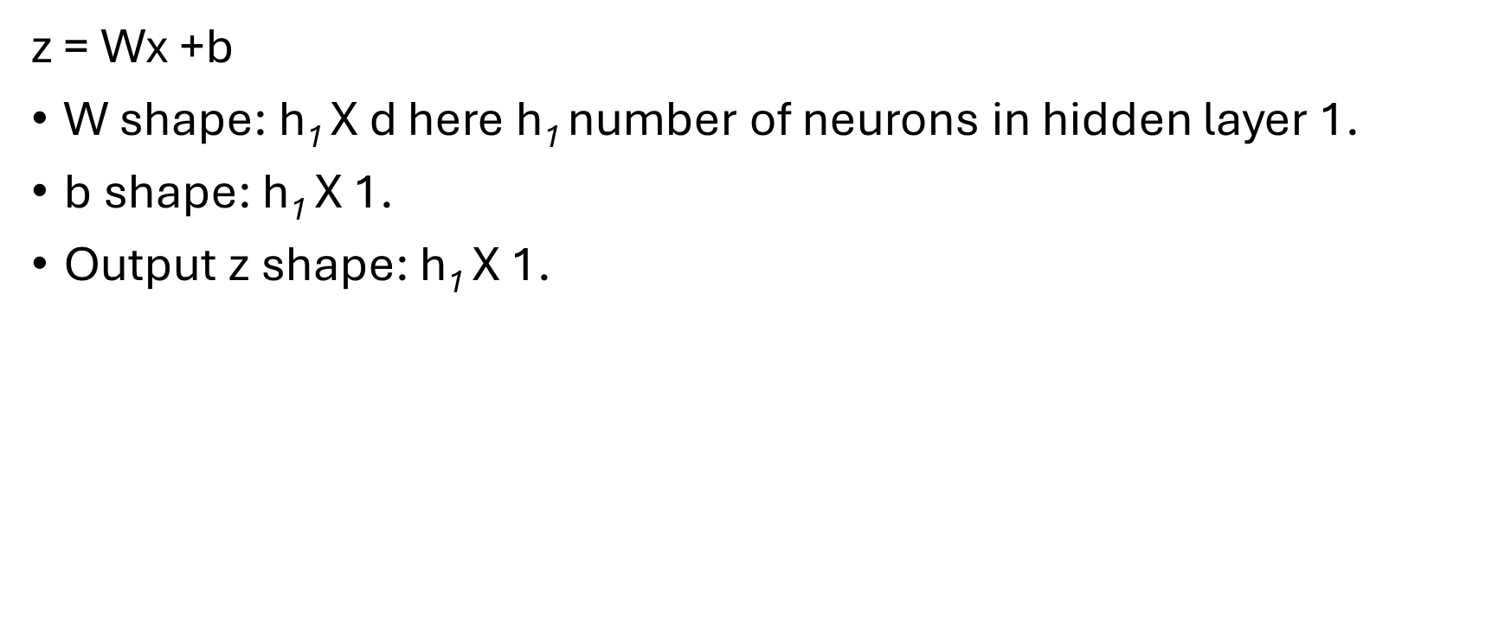
Hidden Layer 1 — Weighted Sum + Activation
z = Wx +b
W shape: h₁ X d here h₁ number of neurons in hidden layer 1.
b shape: h₁ X 1.
Output z shape: h₁ X 1.
Notes:
h₁ = the number of neurons

Slide 10
Hidden Layer 2 (optional)
If it is used, then it repeats the linear to activation pattern:
z = Wa + b, a = ϕ(z)

Slide 11
Output Neuron (Sigmoid for Probability)
p = σ(z) = 1/(1+e^{-z})
p = P(y=1∣x)
Output shape: scalar (or m×1 for a batch).

Slide 12
Output Probability: P(y=1 | X)
It is a network’s estimated probability that the label is 1 given input x. The interpretable value is range of [0,1].

Slide 13

Decision Threshold (0.5)
Convert probability to class with threshold $t$(default 0.5):
y = 1 if p > t
y = 0 if p < t

Slide 14
Final Predicted Class (ŷ)
This is the decision used for metrics like accuracy, F1, confusion matrix.
Loss function is (binary cross-entropy for sigmoid output)
Optimization: compute gradients and update parameters using an optimizer (SGD, Adam, and RMSProp)

Slide 15
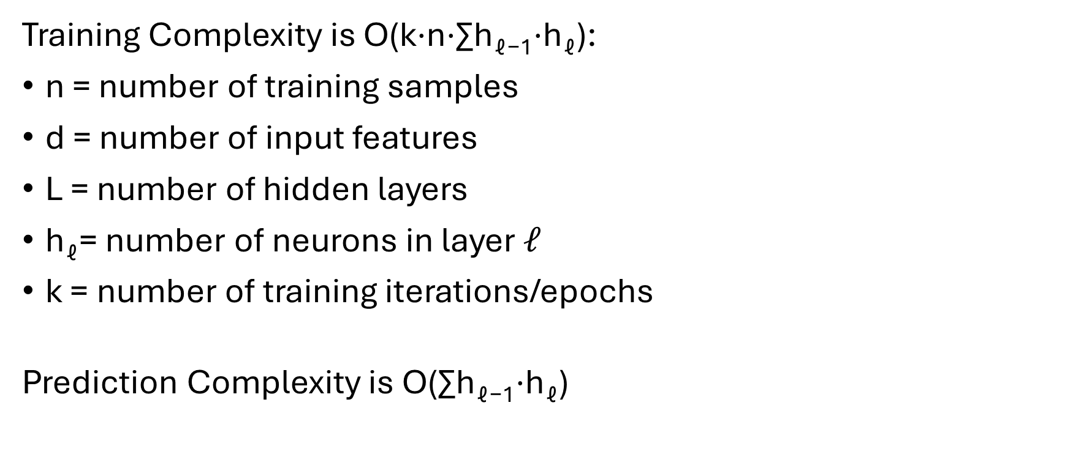
Computational Complexity
Training Complexity is O(k⋅n⋅∑h_{ℓ−1}​⋅h_{ℓ}​):
n = number of training samples
d = number of input features
L = number of hidden layers
h_{ℓ}= number of neurons in layer $𝓁$
k = number of training iterations/epochs
Prediction Complexity is O(∑h_{ℓ−1}​⋅h_{ℓ}​)

Slide 16
Example Application
Notes:
Example Application will based on Marketing

Slide 17
Our Mission
The main objective of our model is to predict which customers are most likely to respond to a product or service offer. This allows businesses to focus their marketing resources more efficiently, improve conversion rates, and make more informed strategic decisions.
We can identify which types of customers are more likely or less likely to respond to a marketing campaign by using this Dataset from Kaggle called Marketing Campaign. By examining consumer attributes such as education level, marital status, income, number of children, and other demographic or behavioral variables

Slide 18
Dataset Description
Number of samples: 2,240 customers
Number of features: 24 input features after encoding (skip DTcustomer, Complain, Z_CostContact, Z_Revenue)
Target variable: Response — 1 if the customer accepted the most recent campaign, 0 otherwise

Slide 19
Implementation – Data Preprocessing
Load Dataset
Cleaning / Handling Missing Values
Define Features and Target
Preprocessing: Encoding & Scaling
Train / Validation / Test Split
Fit Preprocessor and Transform
Output shapes
Notes:
1. Load Dataset
The dataset is loaded from a CSV file, and the column names are cleaned to remove extra spaces.
2. Cleaning / Handling Missing Values
- Numeric features are imputed using the median, which is robust to outliers and preserves the distribution.
- Categorical features are filled with their most frequent category (mode) to avoid losing data while keeping categories valid.
3. Define Features and Target
The target variable (Response) is separated from the feature set. Irrelevant or non-informative columns such as ID fields and administrative variables (Dt_Customer, Z_CostContact, Z_Revenue) are dropped. This prevents data leakage and ensures that the model learns only from meaningful information.
4. Preprocessing: Encoding & Scaling
A preprocessing pipeline is created using ColumnTransformer.
- Numeric features are standardized to have mean 0 and variance 1, improving model stability.
- Categorical features are one-hot encoded, converting categories into binary indicator variables.
5. Train / Validation / Test Split
The dataset is divided into three parts:
- Training set (64%) for model learning
- Validation set (16%) for hyperparameter tuning
- Test set (20%) for final performance evaluation
6. Fit Preprocessor and Transform
The preprocessing pipeline is fitted only on the training set, then applied to the validation and test sets. This prevents information from the validation or test data from leaking into the training process, so it can ensure an honest evaluation of model performance.
7. Output Shapes
The shapes of the processed feature matrices and label vectors are printed. This is confirmation that the preprocessing steps were successful, and give information of the training, validation, and test sets contain the expected number of samples and transformed features.

Slide 20
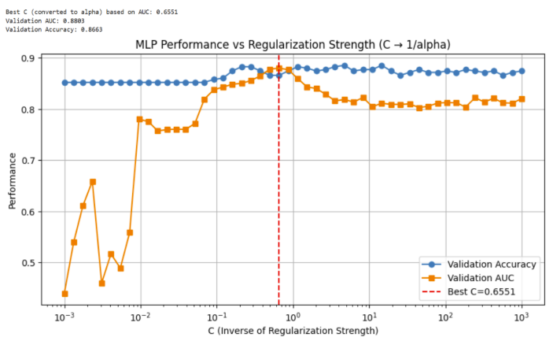
Implementation – Hyperparameter Search for Logistic Regression
Notes:
1. Define Hyperparameter Range
A range of C values is created using a logarithmic scale from 0.001 to 1000.
C controls the inverse of regularization strength:
- Small C → stronger regularization (simpler model)
- Large C → weaker regularization (more flexible model)
2. Train Logistic Regression for Each C
A logistic regression model is trained repeatedly, one for each C value.
The model is fit only on the training data.
Predictions on the validation set provide:
Accuracy: measures how many labels were predicted correctly
AUC (Area Under ROC): measures ranking/separation ability between classes AUC is often preferred because it is more robust to class imbalance. Both metrics are stored for comparison.
3. Find the Best Parameter
The best C value is selected by choosing the model with the highest validation AUC.
This avoids overfitting to accuracy alone and focuses on probability quality and class separation.
4. Plot Performance
A performance curve is created for AUC and accuracy across all C values.
- A logarithmic x-axis visually highlights how performance changes with regularization.
- A vertical line marks the best C.

Slide 21
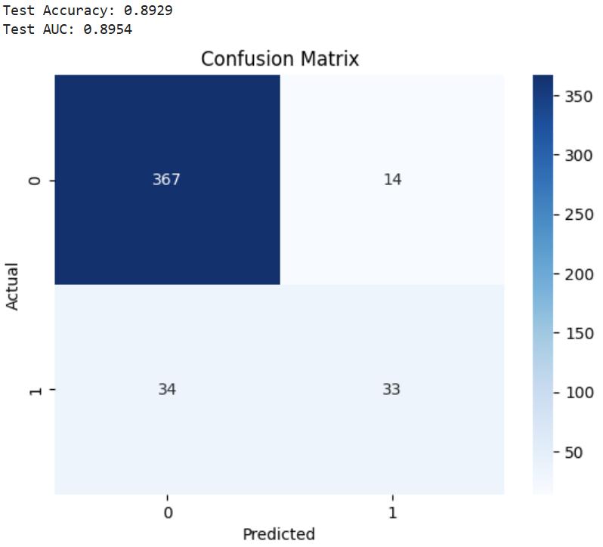
Evaluation – Confusion Metrics

Slide 22
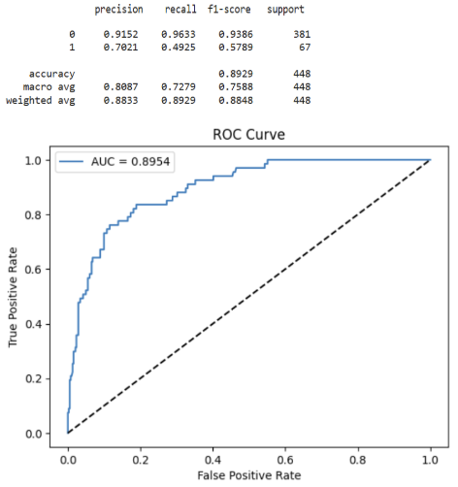
Evaluation – ROC curve

Slide 23
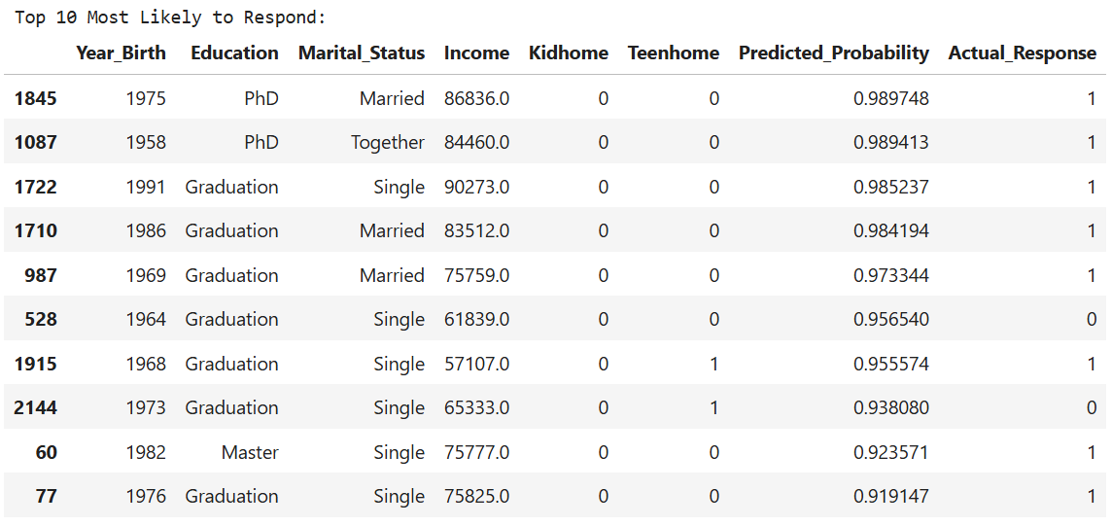
Evaluation – Interpret the coefficients Part 1

Slide 24
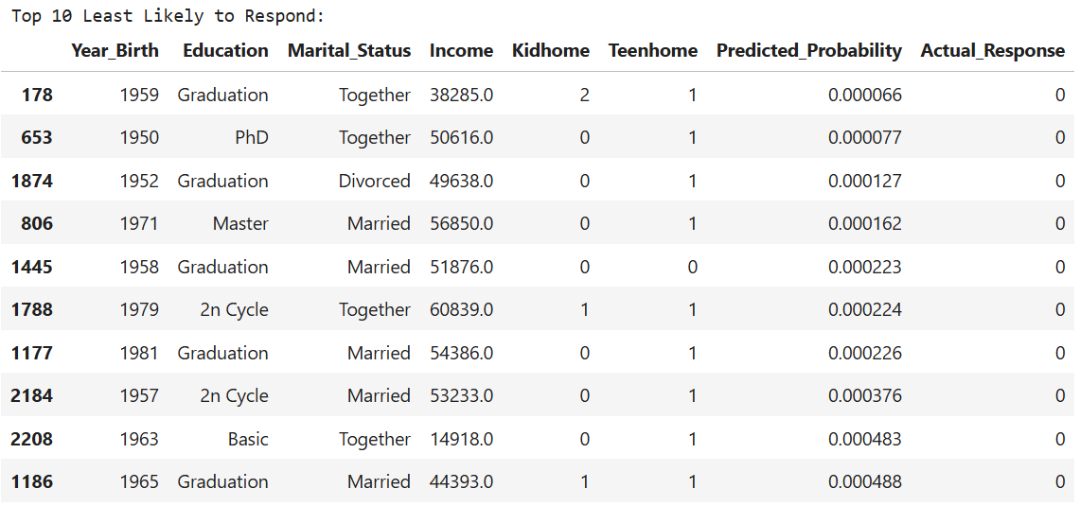
Evaluation – Interpret the coefficient Part 2

Slide 25
Advantages and Disadvantages
Strengths:
- Ability to model non-linear relationships
- Flexibility with input data
- Scalable to large datasets
Weaknesses:
- Requires large amounts of data
- Sensitive to hyperparameters
- Risk of overfitting
- Difficulty with sequential or structured data

Slide 26
Comparison and Alternatives

Slide 27
References:
GeeksforGeeks. (2017, May 9). Logistic Regression in Machine Learning. GeeksforGeeks. https://www.geeksforgeeks.org/machine-learning/understanding-logistic-regression/
‌ Lee, F. (2025, May 14). Logistic Regression. Ibm.com. https://www.ibm.com/think/topics/logistic-regression
Brownlee, J. (2016, September 22). Logistic Regression for Machine Learning. Machine Learning Mastery. https://machinelearningmastery.com/logistic-regression-for-machine-learning/

